Slide 1

Saving Nostalgia
Modding an old Z80 computer
PRESENTED BY:
Graham Sutherland
Penetration Tester, Cisco/Portcullis
Slides licensed under CC-BY-SA 3.0

Slide 2
This talk
Background
Reverse engineering
Understanding the Z80 system
Approaches
Design
Fabrication
Result

Slide 3
Background

Slide 4
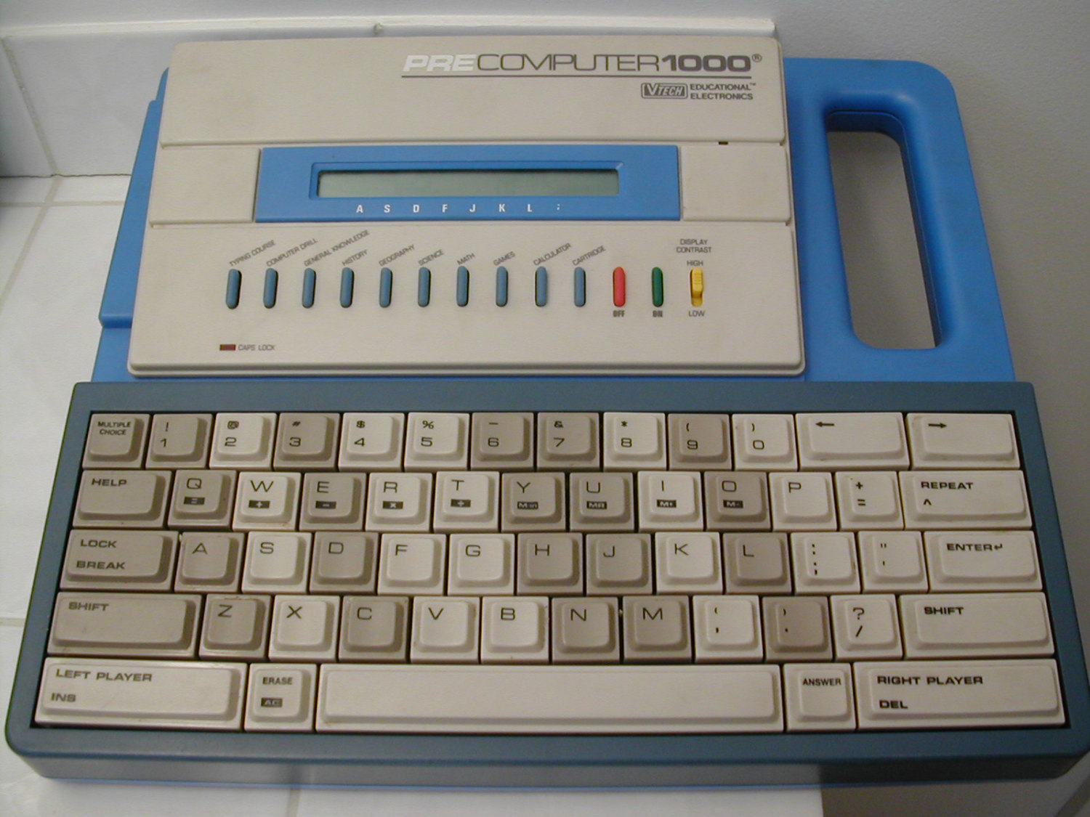

Slide 5
Video time!
LibreOffice is awful and
won’t let me embed a video
>_<

Slide 6
Some history [1/2]
1988
  I was born.
  VTech released the PreComputer 1000.
1994
  My parents bought me one.
  I pressed buttons at random, got stuck in “Computer Drill” mode (???)
  Read the manual.
  Learned BASIC!
1995-2013
  Education, etc.
  Taught myself programming & security stuff.
  Taught myself electronics (with some help from my dad)
  The PreComputer 1000 languished in storage, was eventually sold :(
2013
  Joined Portcullis Computer Security.
  First pentesting job.
  Getting into the demoscene.

Slide 7
Some history [2/3]
2015
  Portcullis acquired by Cisco.
  I guess I work for Cisco now?
May 2016
  Random thought: “Remember that old thing?”
  Thought it’d be cool to write demos for it.
  Got one on eBay for £20.
  Nostalgia!
  Took it apart immediately to see how it works.
  “Kinda hard to write demos on something that doesn’t have storage...”
June to August 2016
  Learned about Z80 system architecture.
  Started designing a mod which allows me to save BASIC programs.
  Multiple design iterations, different part selection, lots of headaches.
  Finalised design, got boards made.
  Life stuff = delays.

Slide 8
Some history [3/3]
September 2016
  Getting tight on time!
  Ordered the parts.
  Soldered it all together.
  ???
Today
  44CON talk!

Slide 9
Details
Some detail about topic 1
Another detail about topic 1

Slide 10
Second Topic

Slide 11
Details
Interesting point about topic 2
Another interesting point about topic 2

Slide 12
Summary
Quick point to summarize topic 1
Quick point to summarize topic 2

Slide 13
Questions?
CONTACT:
example@fedoraproject.org
License statement goes here. Creative Commons licenses are good.

